Slide 1
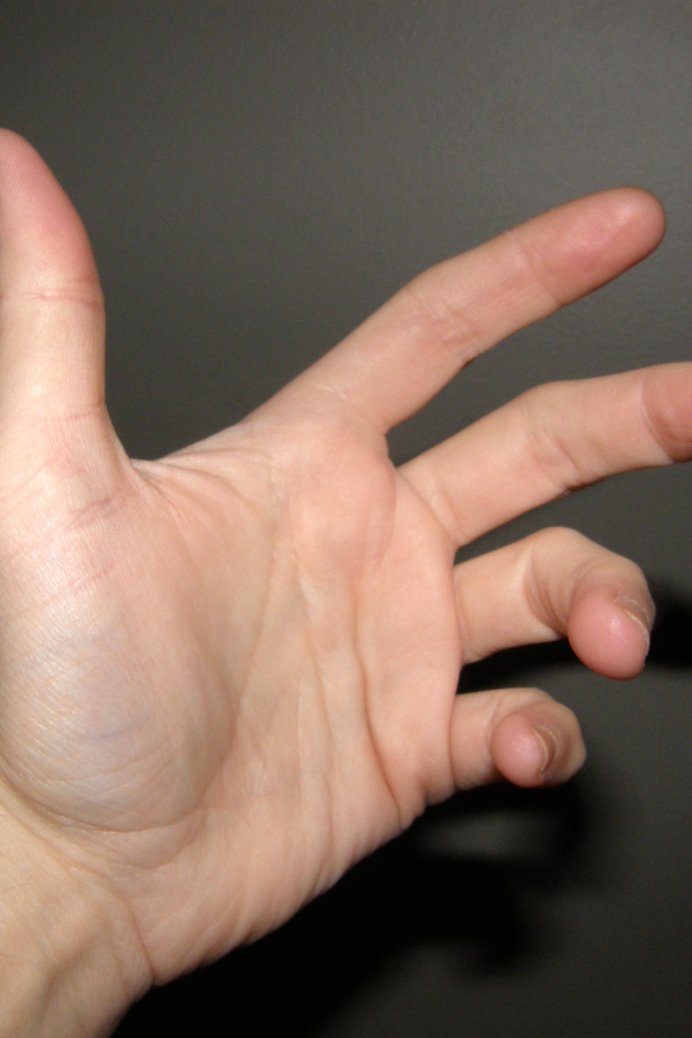
Hand Gesture Recognition Using OpenCV
Unlock the potential of hand gesture recognition using state-of-the-art deep learning techniques. Explore its applications and learn how to implement this groundbreaking technology.

Slide 2

Abstract
This project is focused on hand gesture recognition using deep learning. The goal is to develop a model that can accurately recognize and interpret hand gestures in real-time. The implementation of the project involves data collection, including the acquisition of datasets specifically designed for hand gestures. The project also includes the code for implementing the hand gesture recognition algorithm, which utilizes contour detection and neural networks.
The challenges in hand gesture recognition are discussed, along with the explanation of the libraries used in the project. The training and testing of the hand gesture recognition model are explained in detail, highlighting the techniques and methodologies employed. The applications of hand gesture recognition technology are explored, showcasing its potential in various fields. The project concludes with a Q&A session and provides references for further reading.

Slide 3
Introduction
Welcome to the world of hand gesture recognition using deep learning! This project aims to explore the fascinating field of interpreting and understanding human hand gestures through advanced machine learning techniques. Hand gesture recognition has gained significant attention due to its potential applications in various domains, including human-computer interaction, virtual reality, robotics, and more.
In this project, we will delve into the implementation and development of a hand gesture recognition system using deep learning algorithms. We will explore the process of collecting hand gesture datasets specifically designed for training and testing the model. Additionally, we will discuss the code and techniques used to implement contour detection and neural networks for accurate gesture recognition.
Moreover, we will explore the wide range of applications for hand gesture recognition technology, highlighting its potential to revolutionize fields such as human-computer interaction, sign language interpretation, virtual reality experiences, and more.
We're excited to embark on this journey of hand gesture recognition using deep learning with you. Let's get started!

Slide 4
Introduction to Deep Learning
1
The Power of Neural Networks
2
Understanding Gestures
3
Advantages of Deep Learning
Explore the basics of deep learning and how it revolutionizes pattern recognition.
Dive into the complexity of hand gestures and the importance of accurately capturing their nuances.
Discover how deep learning models excel in dealing with the intricacies of hand gesture recognition compared to traditional approaches.

Slide 5
Analysis of This Project
The project "Hand Gesture Recognition Using Deep Learning" aims to explore interpreting and understanding human hand gestures through advanced machine learning techniques. By leveraging deep learning algorithms, the project focuses on developing a hand gesture recognition system.
The project consists of key components such as data collection, code implementation, challenges in hand gesture recognition, neural networks for gesture recognition, training and testing a hand gesture recognition model, and applications of hand gesture recognition technology.
Specific hand gesture datasets are collected and used for training and testing the model. The code implementation involves contour detection and the utilization of neural networks for accurate gesture recognition.
The project addresses challenges associated with hand gesture recognition and explores libraries and tools used in the implementation. Additionally, it highlights the wide range of applications for hand gesture recognition technology, including human-computer interaction, sign language interpretation, and virtual reality experiences.
Thank you for your interest in this project. We hope this provides an overview of the project's scope and objectives.

Slide 6
Implementation of This Project
Data Collection
Preprocessing
Model Selection
Gather a diverse dataset of hand gestures, ensuring wide coverage.
Clean and prepare the data for training a robust recognition model.
Explore various deep learning architectures suitable for gesture recognition tasks and choose the most appropriate one.

Slide 7
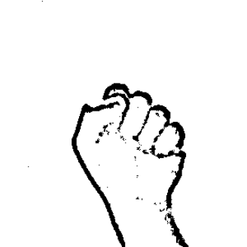
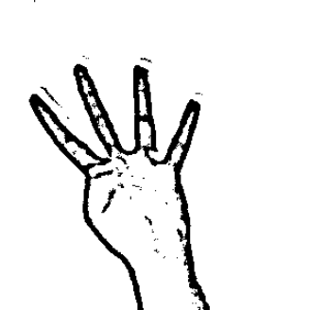
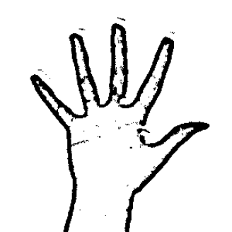
Data Sets for Hand Gestures
Closed Fist
Open Hand
Thumbs Down

Slide 8
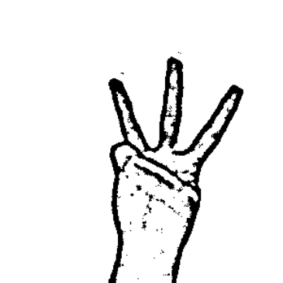
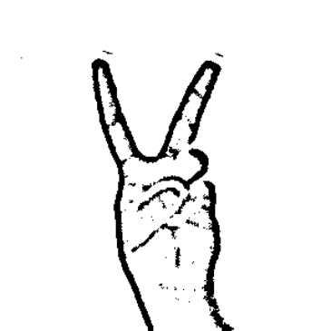

Data Sets for Hand Gestures
Three Fingers
Peace Sign
Pointing Finger

Slide 9
Code for Implementation
import cv2
import numpy as np
import math
cap = cv2.VideoCapture(1)
while True:
_, img = cap.read()
cv2.rectangle(img, (400, 400), (50, 50), (0, 255, 0), 0)
crop_img = img[50:400, 50:400]
grey = cv2.GaussianBlur(cv2.cvtColor(crop_img, cv2.COLOR_BGR2GRAY), (35, 35), 0)
, thresh1 = cv2.threshold(grey, 127, 255, cv2.THRESHBINARY_INV + cv2.THRESH_OTSU)
cnt = max(cv2.findContours(thresh1.copy(), cv2.RETR_TREE, cv2.CHAIN_APPROX_NONE)[-2], key=lambda x: cv2.contourArea(x))
defects = cv2.convexityDefects(cnt, cv2.convexHull(cnt, returnPoints=False))
count_defects = sum(math.acos(
math.sqrt((d[0, 2] - d[0, 0]) 2 + (d[0, 3] - d[0, 1]) 2) /
(math.sqrt((d[0, 4] - d[0, 0]) 2 + (d[0, 5] - d[0, 1]) 2) *
math.sqrt((d[0, 4] - d[0, 2]) 2 + (d[0, 5] - d[0, 3]) 2))

Slide 10
Code for Implementation (Contd..)
) <= 90 for d in defects)
gestures = ["Hello World!!!", "GESTURE ONE", "GESTURE TWO", "GESTURE THREE", "GESTURE FOUR"]
gesture_text = gestures[min(count_defects, 4)]
cv2.putText(img, gesture_text, (50, 50), cv2.FONT_HERSHEY_SIMPLEX, 2, 2)
cv2.imshow('Gesture', img)
cv2.imshow('Contours', np.hstack((np.zeros_like(crop_img), crop_img)))
if cv2.waitKey(1) == 27:
break
cap.release()
cv2.destroyAllWindows()

Slide 11
Explanation of Libraries
cv2
The cv2 library is a popular computer vision library in Python. It provides various functions and tools for image processing, object detection, and computer vision tasks.
numpy
numpy is a powerful numerical computing library in Python. It provides support for large, multi-dimensional arrays and matrices, along with a collection of mathematical functions to operate on these arrays efficiently.
math
The math library in Python provides various mathematical functions and constants. It includes functions for basic arithmetic operations, trigonometry, logarithms, and more.

Slide 12

Challenges in Hand Gesture Recognition
1
Complexity of Gestures
Overcome the challenge of recognizing a wide array of intricate hand gestures with accuracy and efficiency.
2
Interpreting Context
Address the difficulty of understanding gestures within the context they are performed, ensuring consistent recognition.
3
Variability in Lighting and Backgrounds
Tackle the impact of varying lighting conditions and backgrounds on gesture recognition performance.

Slide 13
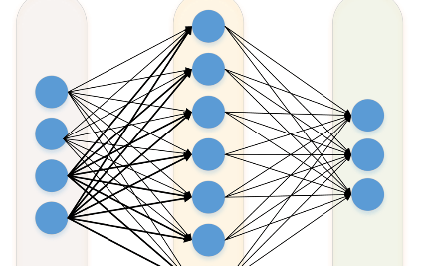
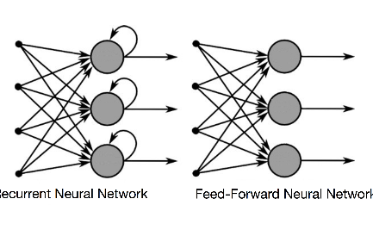
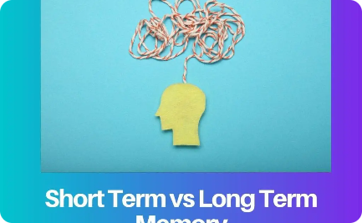
Neural Networks for Gesture Recognition
Convolutional Neural Networks (CNN)
Recurrent Neural Networks (RNN)
Long Short-Term Memory (LSTM)
Explore the power of CNNs in detecting meaningful patterns in hand gestures and achieving high recognition accuracy.
Understand how RNNs capture temporal dependencies in hand gestures, making them effective for continuous gesture recognition tasks.
Learn about LSTM units and their role in processing sequential data, making them suitable for gesture recognition in videos.

Slide 14

Training and Testing a Hand Gesture Recognition Model
1
Data Partitioning
Split the dataset into training, validation, and testing sets for model development and evaluation.
2
Model Training
Train the neural network using the training set, fine-tuning hyperparameters and network architecture to achieve optimal performance.
3
Model Testing
Evaluate the trained model on the testing set to measure its accuracy and generalization capabilities.

Slide 15
Applications of Hand Gesture Recognition Technology
Human-Computer Interaction
Virtual Reality and Gaming
Discover how hand gesture recognition enhances interactions with computers, enabling natural and intuitive control.
Explore the immersive possibilities of hand gesture recognition in virtual reality experiences and gaming.
Sign Language Interpretation
Healthcare and Rehabilitation
Learn how hand gesture recognition empowers individuals with hearing impairments by enabling real-time sign language translation.
See how gesture recognition technology revolutionizes physical therapy and assists individuals with motor impairments.

Slide 16

Conclusion
Sum up the key takeaways of the presentation and open the session for questions and discussions.

Slide 17

References
ChatGPT
Introduction to Artificial Intelligence
w3schools
Gamma AI

Slide 18
Thank You
About Me
Name: Gembali Rohit
Email: gembalirohit2003@gmail.com

